Slide 1
Developing Robust Autonomous Wall-Following Algorithms
Team 13 Lab 3 Briefing
Xavier (2A), Insuh (16), Inimai (6-2), Russell (6-2)
3/10/25

Slide 2
Our Goal
Develop a robust method for autonomous wall-following
Navigate new environments
Use LIDAR
Avoid collisions
Follow some desired path

Slide 3
Technical objectives
Effective safety controller: brakes to interrupt collision trajectories, but does not stop prematurely when merely driving close to the wall
Effective wall-following algorithm: maintains a desired wall distance with minimal oscillation, and quickly converges to this behavior in response to disturbances (turns, stop/start)

Slide 4
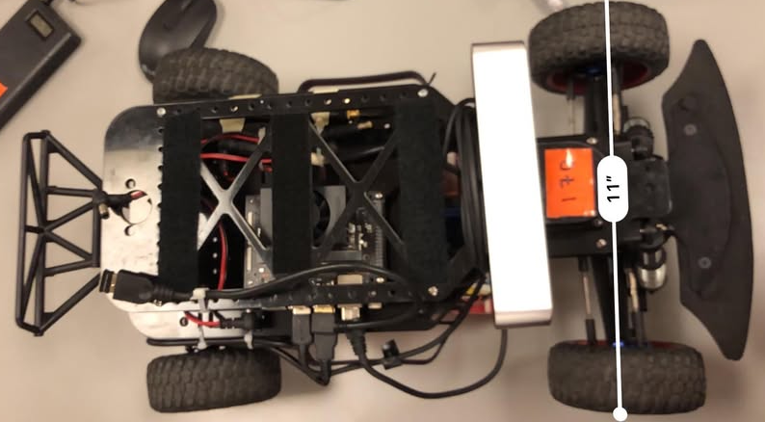
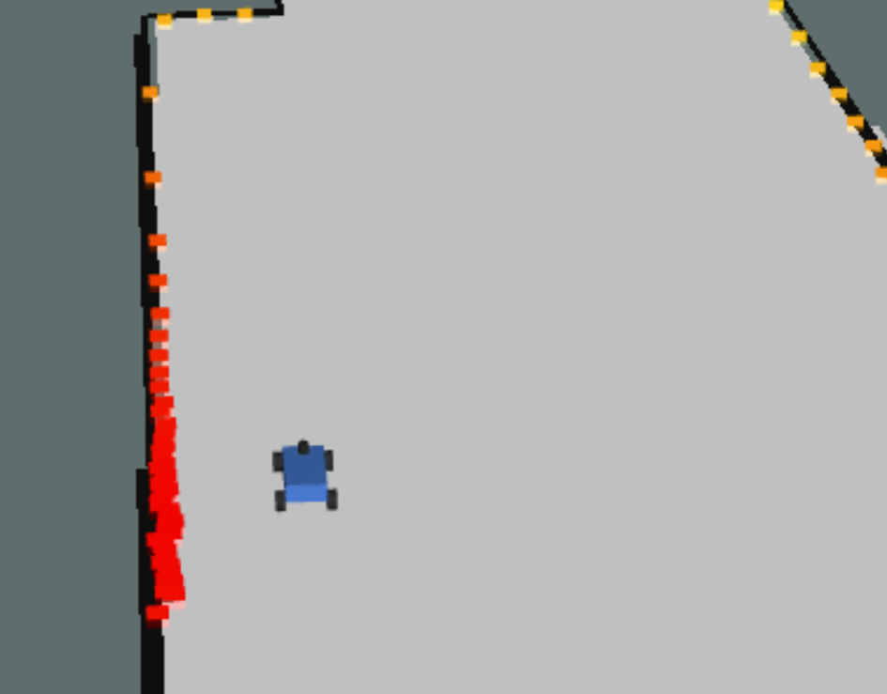
From Simulation to Racecar
Well-defined walls / obstacles
Ideal physics (0 stop distance)
Low noise signal
Collisions are ok when testing
Imperfect hardware response to commands
Prevent collisions (safety controller)
Possibly mid-noise signal

Slide 5
Technical Overview
Wall follower is built around PID control
Safety controller works on principle of stopping distance

Slide 6
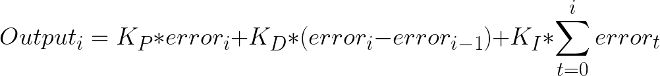
Defining our PID approximation
discretized integral
approx derivative
Steering output as a linear, weighted sum of distinct error quantifications

Slide 7
Wall follower iteration in sim
Filtered data (general)
LiDAR measurements
Linear Regression
Estimate wall line & car position
Filter by angle & distance
Robot distance from the wall
Filtered data (front-facing)
Side
Wall Follower (PID)
wall side
desired distance
velocity
front-distance
previous error
Ackermann CMD
Robot Actuator
Technical Overview
Notes:
Weight error by mean front-facing [-pi/6, pi/6] LIDAR distance
Forces tight turns when coming up against a wall

Slide 8
Wall follower iteration in sim
Filtered data (general)
LiDAR measurements
Linear Regression
Estimate wall line & car position
Filter by angle & distance
Robot distance from the wall
Filtered data (front-facing)
Side
Wall Follower (PID)
wall side
desired distance
velocity
front-distance
previous error
+ cumulative error
Ackermann CMD
Robot Actuator
Technical Overview
Notes:
Weight error by mean front-facing [-pi/6, pi/6] LIDAR distance
Forces tight turns when coming up against a wall

Slide 9

Safety controller to prevent crashes.
Buffer distance
π/3
Technical Overview

Slide 10
Safety controller to prevent crashes.
Buffer distance
DOES NOT scale well with changing velocities
π/3
Technical Overview

Slide 11
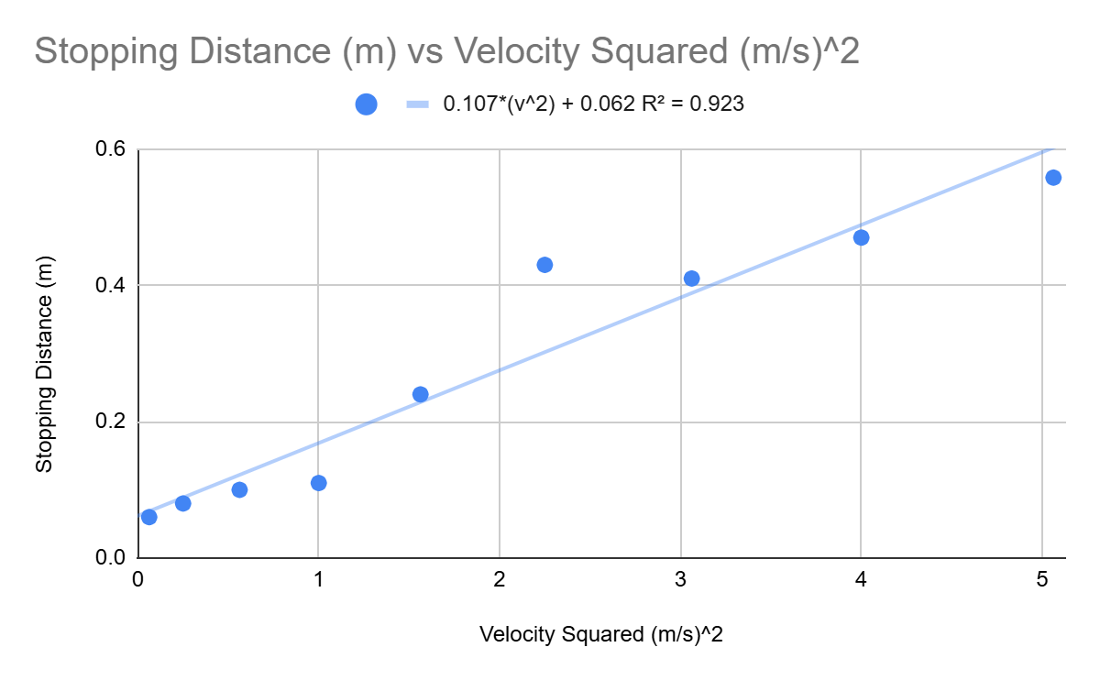
Stopping distance is proportional to car velocity squared.
Velocity (m/s) Car is Driving At | Stopping Distance (m)
0.25 | .06
0.5 | .08
0.75 | .10
1 | .11
1.25 | .24
1.5 | .43
1.75 | .41
2 | .47
2.25 | .558
Technical Overview

Slide 12
To prevent crashes, we implemented a safety controller.
Extra buffer
Buffer distance
Stopping distance
π/3
Distance to bumper
Technical Overview

Slide 13
To prevent crashes, we implemented a safety controller.
Can handle changing velocities
Extra buffer
Stopping distance
Too safe for obstacles at angles far from 90 degrees
Distance to bumper
Technical Overview

Slide 14
To prevent crashes, we implemented a safety controller.
ADD for steering angle commands not at 90 deg:
Extra buffer
Stopping distance
Distance to bumper
Distance to bumper
Stopping distance
Extra buffer
Technical Overview

Slide 15
Our Evaluation
what is an effective wall-follower?
Robust to disturbances (turns, start/stop)
Converges quickly to desired path
Differentiate collision cases from safe navigation

Slide 16
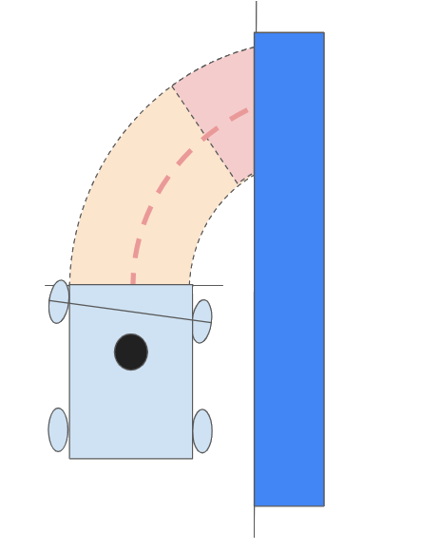
Safety Controller
!
Curved path < safe distance
1) Slow
2) Stop
3) Re-steer
Steady operation near wall
Evaluation
Notes:
When driving close to wall, safety should not kick in, but if the steering turns towards the wall and the trajectory to wall is too close, racecar should stop, leave a buffer zone, and change steering to minimize damage in the event of a collision.
Reasoning, testing:
This is important to the functionality of the safety controller. The controller should only take over navigation to prevent an impending collision, but ideally it will be able to differentiate between uncontrolled proximity and controlled proximity as created by an effective wall following algorithm.
Given a working wall-follower, we can test the effectiveness of the controller by:
decreasing the desired wall distance until the combined safety, wall follower stops the car
disabling the safety controller
Testing to see if the wall follower is able to successfully control the car at that distance
If not, the safety controller did its job
If it can, the safety controller is too protective
Note, the safety controller should also not allow the car to crash at any point -> this indicates under-protection

Slide 17
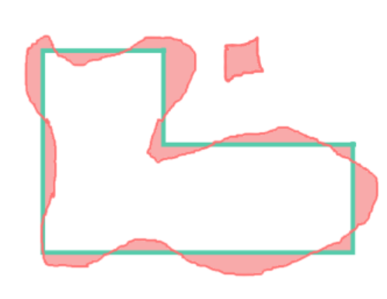
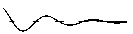
Wall Follower
= ∫error
(Acceptable Error Amplitude)
(Target Distance)
]
(Convergence Time)
Evaluation
Notes:
Wall follower:
Track number of oscillations, or elapsed time, until error amplitude converges below some threshold
Track averaged error over time between proximity and desired distance

Slide 18
Results
Visualize:
Safety controller: test to failure
Wall follower: averaged error, oscillations until error converges

Slide 19
Conclusions
1) our wall follower uses PID control to maintain desired distance to wall
Tested with oscillatory convergence, average error

Slide 20
Conclusions
1) our wall follower uses PID control to maintain desired distance to wall
Tested with oscillatory convergence, average error
2) our safety controller builds a buffer zone around the car based on velocity
Tested by finding limit case

